Slide 1

Lecture-1
Introduction to Computer Networks & Network Models
Core Topics:
Definition and Goals of Networking
Types: LAN, WAN, PAN
OSI and TCP/IP Models: Layer-wise Responsibilities
Protocols Overview (IP, TCP, UDP, HTTP, FTP)

Slide 2

Computer Networks
Definition
A computer network is a collection of interconnected devices (computers, servers, network devices) that communicate and share resources.
Key Elements:
Computers/Devices
Communication links
Network devices (routers, switches)
Network protocols

Slide 3
Importance
Resource Sharing: Enables sharing of resources such as printers, files, and internet connections.
Communication: Facilitates communication through emails, instant messaging, and video conferencing.
Data Exchange: Allows for the exchange of data and information between devices.

Slide 4
Goals of Networking
1. Resource Sharing: Access shared hardware like printers, storage, or software.
2. Communication: Exchange of information via email, messaging, video conferencing.
3. Remote Access: Access resources and systems from different locations.
4. Scalability: Easily add new devices or services.
5. Reliability and Redundancy: Ensure continuous operation and data availability.

Slide 5
Benefits of Networking
Cost efficiency
Centralized data management
Improved productivity and collaboration
Data security and backup

Slide 6
Real-Life Applications
Office and corporate networks
Educational institutions
Cloud computing
E-commerce and online services

Slide 7
Applications
E-mail
Searchable Data (Web Sites)
E-Commerce
News Groups
Internet Telephony (VoIP)
Video Conferencing
Chat Groups
Instant Messengers
Internet Radio

Slide 8
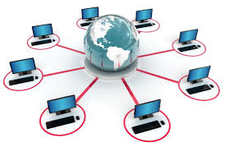
Computer Network

Slide 9
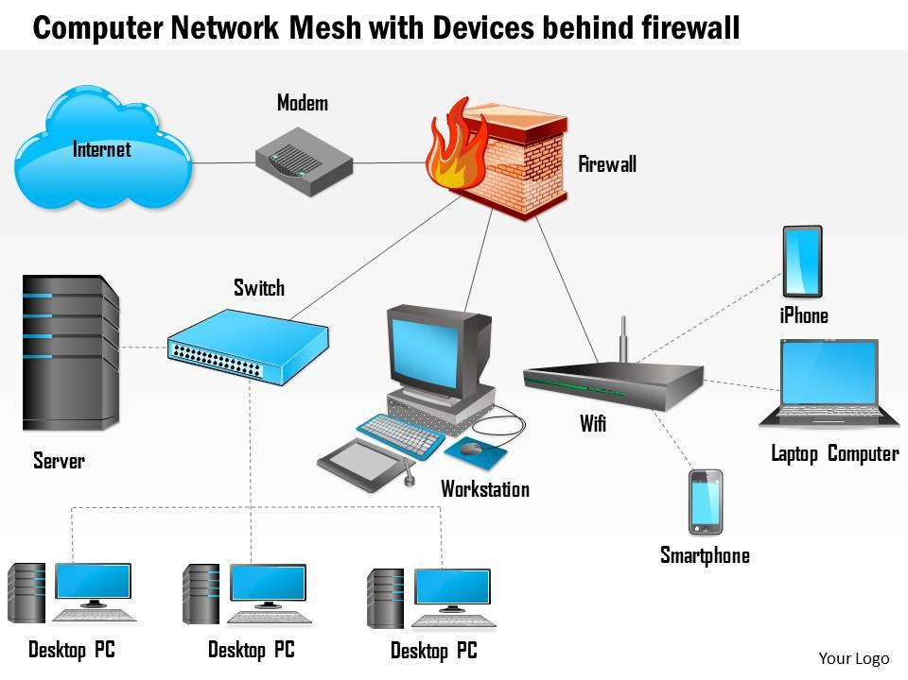
Computer Network

Slide 10
Computers: Clients and Servers
In a client/server network arrangement, network services are located in a dedicated computer whose only function is to respond to the requests of clients.
The server contains the file, print, application, security, and other services in a central computer that is continuously available to respond to client requests.

Slide 11
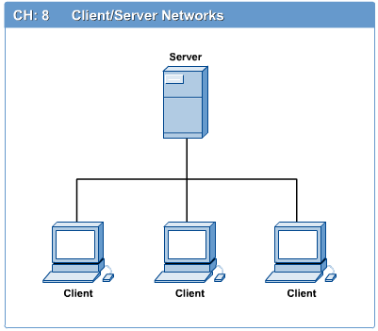

Slide 12
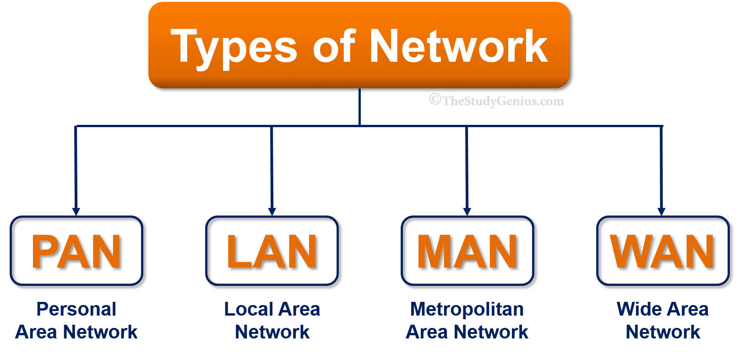
LAN, MAN, PAN and WAN

Slide 13
LAN
LAN (Local Area Network) connects devices in a small area like a home or office, MAN (Metropolitan Area Network) spans a city or large campus, and WAN (Wide Area Network) covers broader geographical areas like the Internet, connecting multiple MANs and LANs.
LAN (Local Area Network):
Definition: A network that connects devices within a small geographical area.
Examples: Home network, office network, school network.
Characteristics: Private, high speed, easy maintenance.
Ownership: Typically private, owned by individuals or organizations.
Cost: Least expensive to implement.
Speed: Fast, with transmission rates up to 800 to 1000 mbps.

Slide 14
MAN
Definition: A network that connects devices within a metropolitan area, such as a city or a large campus.
Examples: City-wide telecommunications network, university campus network.
Characteristics: Larger than a LAN, smaller than a WAN.
Ownership: Can be private or public.
Cost: More expensive than LAN but less expensive than WAN.
Speed: Moderate, with transmission rates up to 50 to 100 mbps.

Slide 15
WAN
WAN (Wide Area Network):
Definition: A network that connects devices across a large geographical area, such as a country or continent.
Examples: The Internet, a network connecting offices across different countries.
Characteristics: Global in scope, connects multiple MANs and LANs.
Ownership: Can be private or public.
Cost: Most expensive to implement.
Speed: Slower than LAN and MAN, transmission rates typically below 100 mbps.

Slide 16
PAN
PAN (Personal Area Network):
Connects devices within a small radius, typically around 30 feet.
Examples: Bluetooth, Wi-Fi for personal devices.
Used for communication between devices within a person's immediate vicinity.

Slide 17
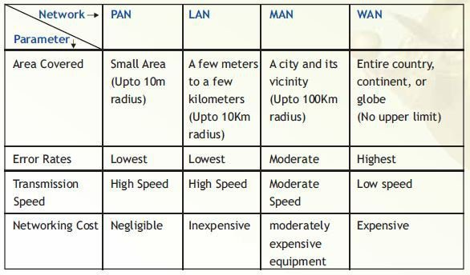

Slide 18
OSI Model
This model is based on a proposal developed by the International Standards Organization (ISO) as a first step toward international standardization of the protocols used in the various layers.
The model is called the Open Systems Interconnection (OSI) Reference Model because it deals with connecting open systems. It was first introduced in the late 1970s.
An open system is a set of protocols that allows any two different systems to communicate regardless of their underlying architecture.

Slide 19
The purpose of the OSI model is to show how to facilitate communication between different systems without requiring changes to the logic of the underlying hardware and software.
The OSI model is not a protocol; it is a model for understanding and designing a network architecture that is flexible, robust, and interoperable.
The OSI model is a layered framework for the design of network systems that allows communication between all types of computer systems.

Slide 20
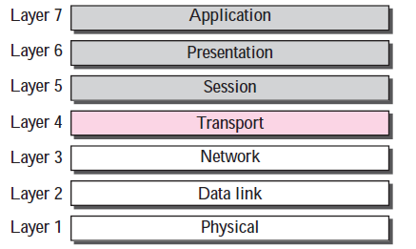
It consists of seven separate but related layers, each of which defines a part of the process of moving information across a network

Slide 21
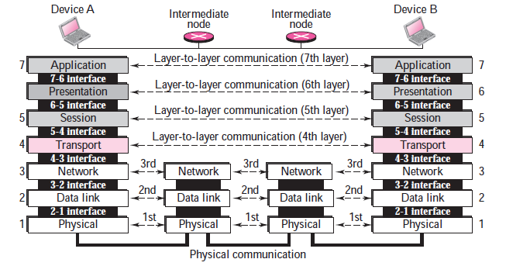

Slide 22
As the message travels from A to B, it may pass through many intermediate nodes. These intermediate nodes usually involve only the first three layers of the OSI model.
Each layer defines a family of functions distinct from those of the other layers.
Within a single machine, each layer calls upon the services of the layer just below it. Layer 3, for example, uses the services provided by layer 2 and provides services for layer 4.

Slide 23
Physical Layer
The physical layer coordinates the functions required to carry a bit stream over a physical medium.
It deals with the mechanical and electrical specifications of the interface and transmission media.
It also defines the procedures and functions that physical devices and interfaces have to perform for transmission to occur.

Slide 24
Physical characteristics of interfaces and media.
The physical layer defines the characteristics of the interface between the devices and the transmission media.
It also defines the type of transmission media.
Representation of bits.
To be transmitted, bits must be encoded into signals—electrical or optical. The physical layer defines the type of encoding (how 0s and 1s are changed to signals).
Data rate.
The transmission rate—the number of bits sent each second.

Slide 25
Synchronization of bits -the sender and the receiver clocks must be synchronized.
Line configuration (point-to-point, multipoint).
Physical topology (mesh, bus, star, ring)
Transmission mode (simplex mode, half-duplex, full-duplex)

Slide 26
Data Link Layer
The data link layer transforms the physical layer, a raw transmission facility, to a reliable link. It makes the physical layer appear error-free to the upper layer (network layer).
Framing. -The data link layer divides the stream of bits received from the network layer into manageable data units called frames.

Slide 27
Physical addressing.
If frames are to be distributed to different systems on the network, the data link layer adds a header to the frame to define the sender and/or receiver of the frame. If the frame is intended for a system outside the sender’s network, the receiver address is the address of the connecting device that connects the network to the next one.

Slide 28
Flow control.
If the rate at which the data is absorbed by the receiver is less than the rate produced at the sender, the data link layer imposes a flow control mechanism to prevent overwhelming the receiver.
Error control.
The data link layer adds reliability to the physical layer by adding mechanisms to detect and retransmit damaged or lost frames. It also uses a mechanism to recognize duplicate frames. Error control is normally achieved through a trailer added to the end of the frame.
Access control.
When two or more devices are connected to the same link, data link layer protocols are necessary to determine which device has control over the link at any given time.

Slide 29
Network Layer
The network layer is responsible for the source-to-destination delivery of a packet, possibly across multiple networks (links).
Whereas the data link layer oversees the delivery of the packet between two systems on the same network (link), the network layer ensures that each packet gets from its point of origin to its final destination.
If two systems are connected to the same link, there is usually no need for a network layer. However, if the two systems are attached to different networks (links) with connecting devices between the networks (links), there is often a need for the network layer to accomplish source-to-destination delivery.

Slide 30
Logical addressing.
The physical addressing implemented by the data link layer handles the addressing problem locally. If a packet passes the network boundary, we need another addressing system to help distinguish the source and destination systems. The network layer adds a header to the packet coming from the upper layer that, among other things, includes the logical addresses of the sender and receiver.
Routing.
When independent networks or links are connected together to create internetworks (network of networks) or a large network, the connecting devices (called routers or switches) route or switch the packets to their final destination. One of the functions of the network layer is to provide this mechanism.

Slide 31
Transport Layer
The transport layer is responsible for process-to-process delivery of the entire message. A process is an application program running on the host.
The transport layer, ensures that the whole message arrives intact and in order.
Service-point addressing.
The transport layer header must add a type of address called a service-point address (or port address). The network layer gets each packet to the correct computer; the transport layer gets the entire message to the correct process on that computer.

Slide 32
Segmentation and reassembly.
A message is divided into transmittable segments, with each segment containing a sequence number. These numbers enable the transport layer to reassemble the message correctly upon arriving at the destination and to identify and replace packets that were lost in transmission.
Connection control.
The transport layer can be either connectionless or connection-oriented.
Flow control.

Slide 33
Like the data link layer, the transport layer is responsible for flow control. However, flow control at this layer is performed end to end rather than across a single link.
Error control.
Like the data link layer, the transport layer is responsible for error control. However, error control at this layer is performed process-to-process rather than across a single link. Error correction is usually achieved through retransmission.

Slide 34
Session Layer
The session layer is the network dialog controller. It establishes, maintains, and synchronizes the interaction between communicating systems.
Dialog control.
The session layer allows two systems to enter into a dialog. It allows the communication between two processes to take place in either half-duplex or full-duplex mode.
Synchronization.

Slide 35
The session layer allows a process to add checkpoints (synchronization points) into a stream of data. For example, if a system is sending a file of 2,000 pages, it is advisable to insert checkpoints after every 100 pages to ensure that each 100-page unit is received and acknowledged independently. In this case, if a crash happens during the transmission of page 523, the only pages that need to be resent after system recovery are pages 501 to 523. Pages previous to 501 need not be resent.

Slide 36
Presentation Layer
The presentation layer is concerned with the syntax and semantics of the information exchanged between two systems.
Translation.
The presentation layer is responsible for interoperability between these different encoding methods.
The presentation layer at the sender changes the information from its sender-dependent format into a common format. The presentation layer at the receiving machine changes the common format into its receiver-dependent format.
Encryption.
Compression.

Slide 37
Application Layer
The application layer enables the user, whether human or software, to access the network.
It provides user interfaces and support for services such as electronic mail, remote file access and transfer, shared database management, and other types of distributed information services.

Slide 38
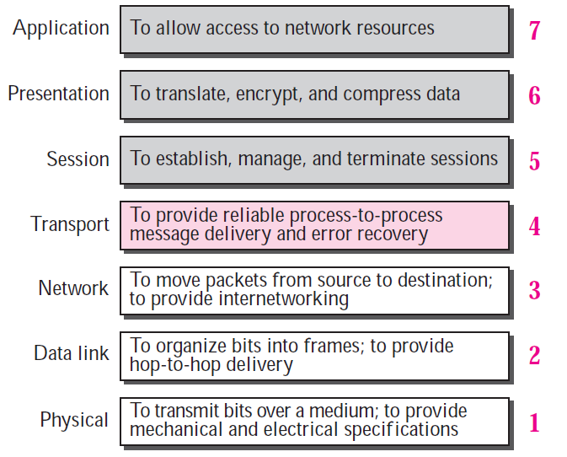
Summary of OSI Layers

Slide 39
TCP/IP PROTOCOL SUITE
The first layered protocol model for internetwork communications was created in the early 1970s and is referred to as the Internet model. It defines four categories of functions that must occur for communications to be successful. The architecture of the TCP/IP protocol suite follows the structure of this model. Because of this, the Internet model is commonly referred to as the TCP/IP model.
The TCP/IP protocol suite was developed prior to the OSI model. Therefore, the layers in the TCP/IP protocol suite do not match exactly with those in the OSI model. The original TCP/IP protocol suite was defined as four software layers built upon the hardware.

Slide 40
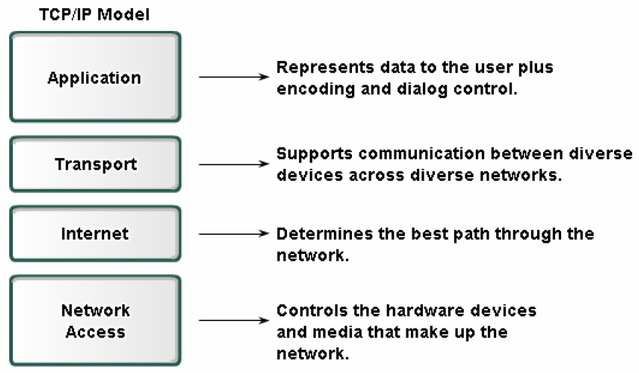
TCP/IP PROTOCOL SUITE

Slide 41
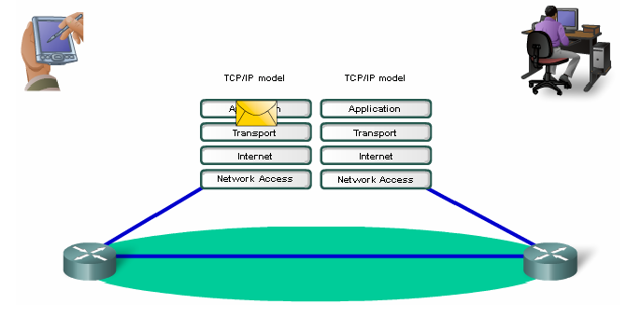

Slide 42
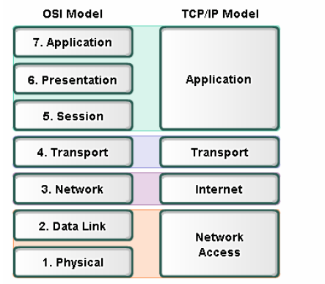

Slide 43
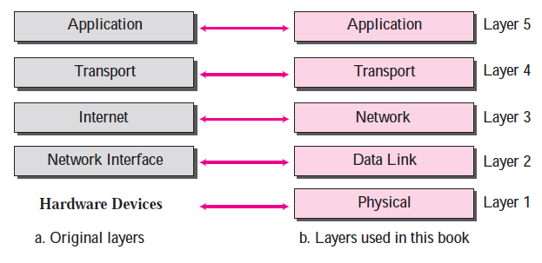
Today, TCP/IP is thought of as a five-layer model with the layers named similarly to the ones in the OSI model.

Slide 44
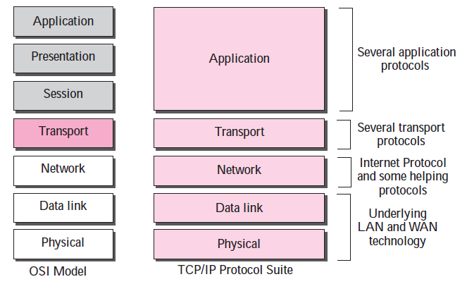
Comparison between OSI and TCP/IP Protocol Suite

Slide 45
Layers in the TCP/IP Protocol Suite
When we study the purpose of each layer, it is easier to think of a private internet, instead of the global Internet. Such an internet is made up of several small networks called links.
A link is a network that allows a set of computers to communicate with each other. A link can be a LAN or WAN.
Our imaginary internet that is used to show the purpose of each layer

Slide 46
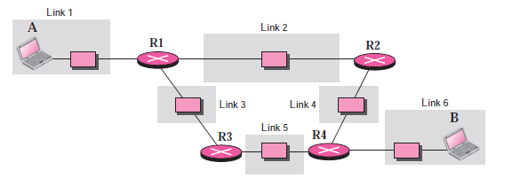

Slide 47
Physical Layer
TCP/IP does not define any specific protocol for the physical layer. It supports all of the standard and proprietary protocols.
At this level, the communication is between two hops or nodes, either a computer or router.
The unit of communication is a single bit. When the connection is established between the two nodes, a stream of bits is flowing between them. The physical layer, however, treats each bit individually.

Slide 48
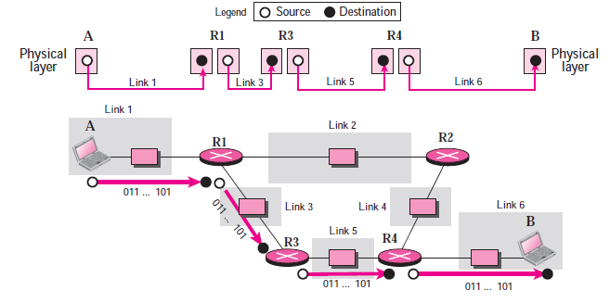
We are assuming that at this moment the two computers have discovered that the most efficient way to communicate with each other is via routers R1, R3, and R4.

Slide 49
Computer A sends each bit to router R1 in the format of the protocol used by link 1. Router 1 sends each bit to router R3 in the format dictated by the protocol used by link 3. And so on.

Slide 50
Data Link Layer
TCP/IP does not define any specific protocol for the data link layer either. It supports all of the standard and proprietary protocols.
At this level, the communication is also between two hops or nodes. The unit of communication however, is a packet called a frame.
A frame is a packet that encapsulates the data received from the network layer with an added header and sometimes a trailer.
The head includes the source and destination of frame. The destination address is needed to define the right recipient of the frame. The source address is needed for possible response or acknowledgment as may be required by some protocols.

Slide 51
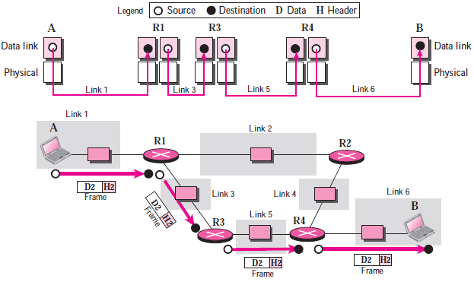

Slide 52
Note that the frame that is travelling between computer A and router R1 may be different from the one travelling between router R1 and R3.
When the frame is received by router R1, this router passes the frame to the data link layer protocol (left). The frame is opened, the data are removed.
The data are then passed to the data link layer protocol (right) to create a new frame to be sent to the router R3

Slide 53
Network Layer
At the network layer (or, more accurately, the internetwork layer), TCP/IP supports the Internet Protocol (IP).
The Internet Protocol (IP) is the transmission mechanism used by the TCP/IP protocols.
IP transports data in packets called Datagrams, each of which is transported separately. Datagrams can travel along different routes and can arrive out of sequence or be duplicated.
IP does not keep track of the routes and has no facility for reordering datagrams once they arrive at their destination.

Slide 54
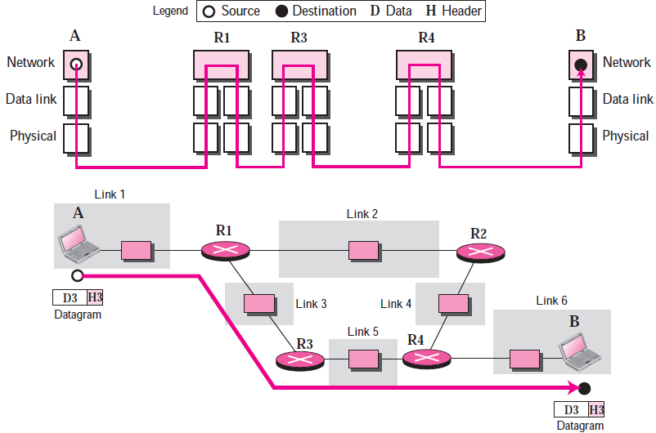

Slide 55
Note that there is a main difference between the communication at the network layer and the communication at data link or physical layers:
Communication at the network layer is end to end while the communication at the other two layers are node to node.
The datagram started at computer A is the one that reaches computer B. The network layers of the routers can inspect (check) the source and destination of the packet for finding the best route, but they are not allowed to change the contents of the packet.

Slide 56
Transport Layer
There is a main difference between the transport layer and the network layer.Although all nodes in a network need to have the network layer, only the two end computers need to have the transport layer.
The network layer is responsible for sending individual datagrams from computer A to computer B; the transport layer is responsible for delivering the whole message, which is called a Segment, a user datagram, or a packet, from A to B.
A segment may consist of a few or tens of datagrams. The segments need to be broken into datagrams and each datagram has to be delivered to the network layer for transmission.

Slide 57
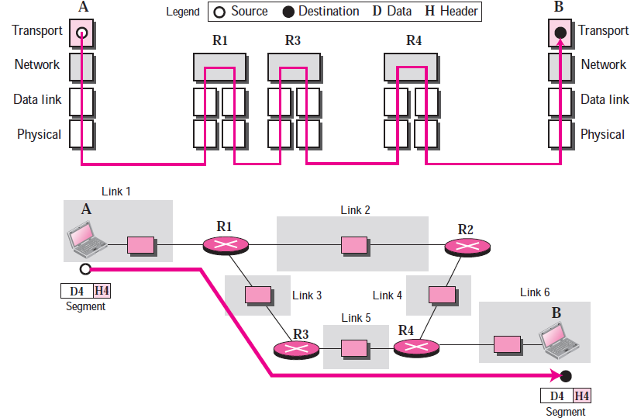

Slide 58
Since the Internet defines a different route for each datagram, the datagrams may arrive out of order and may be lost. The transport layer at computer B needs to wait until all of these datagrams to arrive, assemble them and make a segment out of them.

Slide 59
Traditionally, the transport layer was represented in the TCP/IP suite by two protocols:
Transmission Control Protocol (TCP): is a reliable connection-oriented protocol that allows a byte stream originating on one machine to be delivered without error on any other machine in the internet. TCP also handles flow control to make sure a fast sender cannot swamp a slow receiver with more messages than it can handle.
User Datagram Protocol (UDP): UDP is an unreliable, connectionless protocol for applications that do not want TCP’s sequencing or flow control and wish to provide their own. It is also widely used for one-shot, client-server-type request-reply queries and applications in which prompt delivery is more important than accurate delivery, such as transmitting speech or video. Its advantage low overhead.

Slide 60
Application Layer
The application layer in TCP/IP is equivalent to the combined session, presentation, and application layers in the OSI model. The application layer allows a user to access the services of our private internet or the global Internet. Many protocols are defined at this layer to provide services such as electronic mail, file transfer, accessing the World Wide Web, and so on.
Note that the communication at the application layer, like the one at the transport layer, is end to end. A message generated at computer A is sent to computer B without being changed during the transmission.

Slide 61
Protocols Overview
IP
TCP
UDP
HTTP
FTP

Slide 62
Internet Protocol (IP)
IP provides connectionless (datagram) service
Each packet treated separately
Network layer protocol common to all routers
– which is the Internet Protocol (IP)

Slide 63
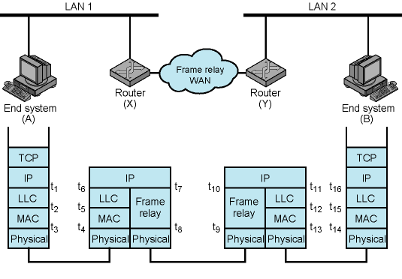
Example Internet Protocol Operation

Slide 64

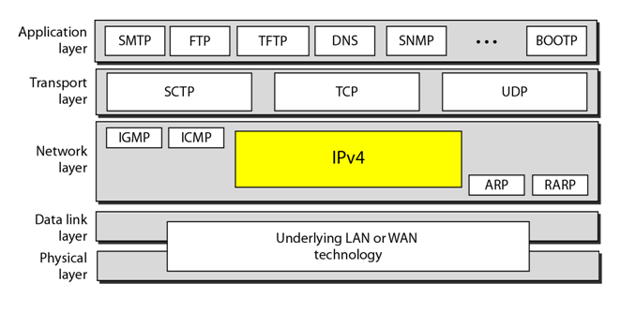
Internet Protocol (IP) Version 4

Slide 65
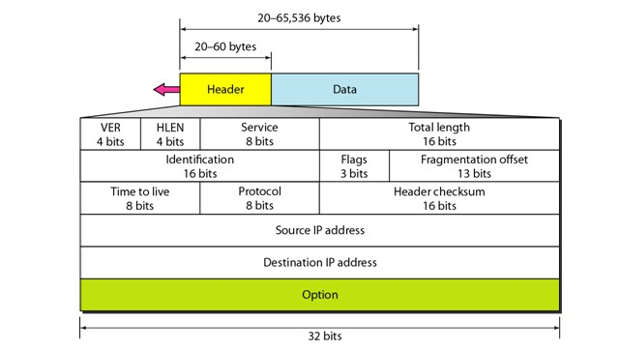
Header + Data using IPv4

Slide 66
An IPv4 address is 32 bits long
The IPv4 addresses are unique and universal
The address space of IPv4 is 2³² or 4,294,967,296
32 bit address is divided into 4 octet ( also known as byte)
To connect on internet each device requires a unique IP address

Slide 67
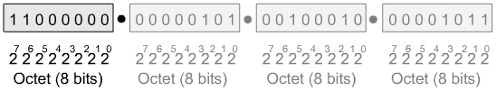
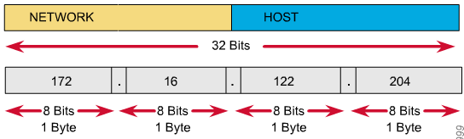
IPv4 Addressing

Slide 68
Eg:
Change the following IPv4 addresses from binary notation to dotted-decimal notation
10000001 00001011 00001011 11101111
Solution
129.11.11.239

Slide 69
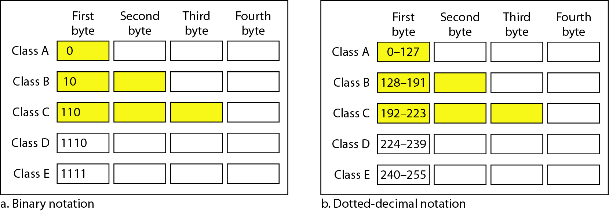
Classful addressing
In classful addressing, the address space is divided into five classes: A, B, C, D, and E

Slide 70
Eg:
Find the class of each address
a. 00000001 00001011 00001011 11101111
b. 11000001 10000011 00011011 11111111
c. 14.23.120.8
d. 252.5.15.111
Solution
a. The first bit is 0. This is a class A address
b. The first 2 bits are 1; the third bit is 0. This is a class C address
c. The first byte is 14; the class is A
d. The first byte is 252; the class is E

Slide 71
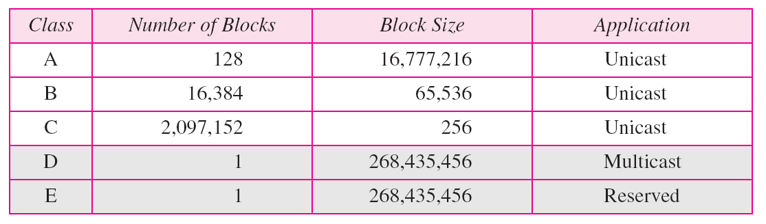
Classes

Slide 72
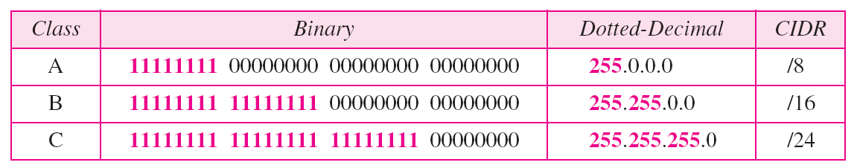
Structure of IPv4 Address
Mask
32-bit number of contiguous 1’s followed by contiguous 0’s
To help to find the net ID and the host ID

Slide 73
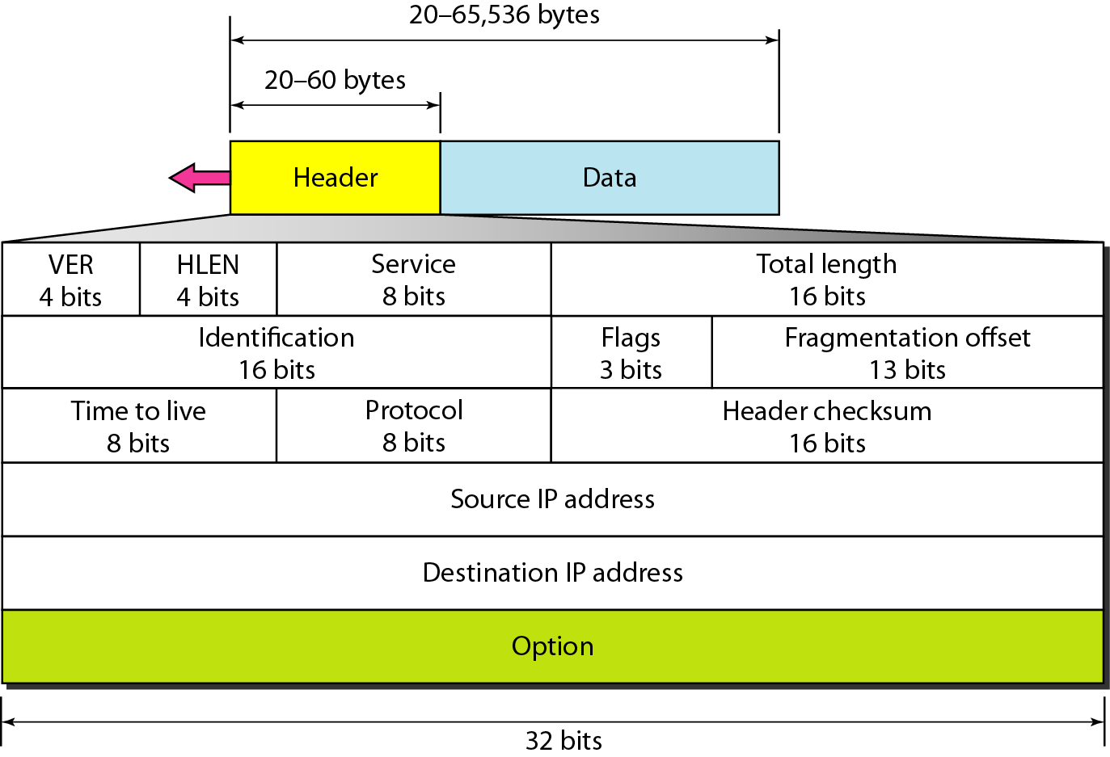
IPv4 datagram format

Slide 74
IPV6
The network layer protocol in the TCP/IP protocol suite is currently IPv4
Although IPv4 is well designed, data communication has evolved since the
inception of IPv4 in the 1970s
IPv4 has some deficiencies that make it unsuitable for the fast-growing Internet

Slide 75
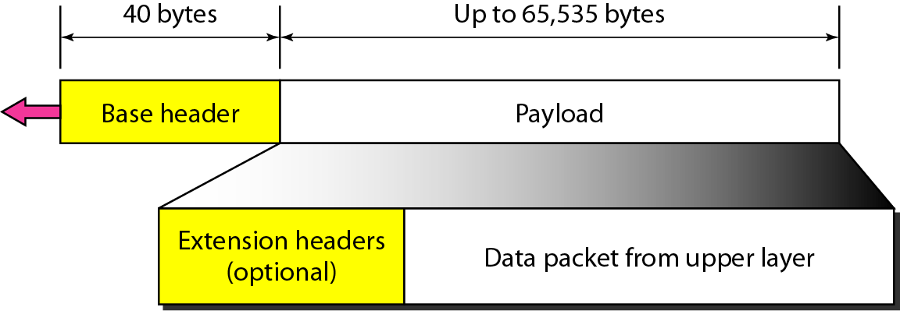
IPv6 datagram header and payload

Slide 76
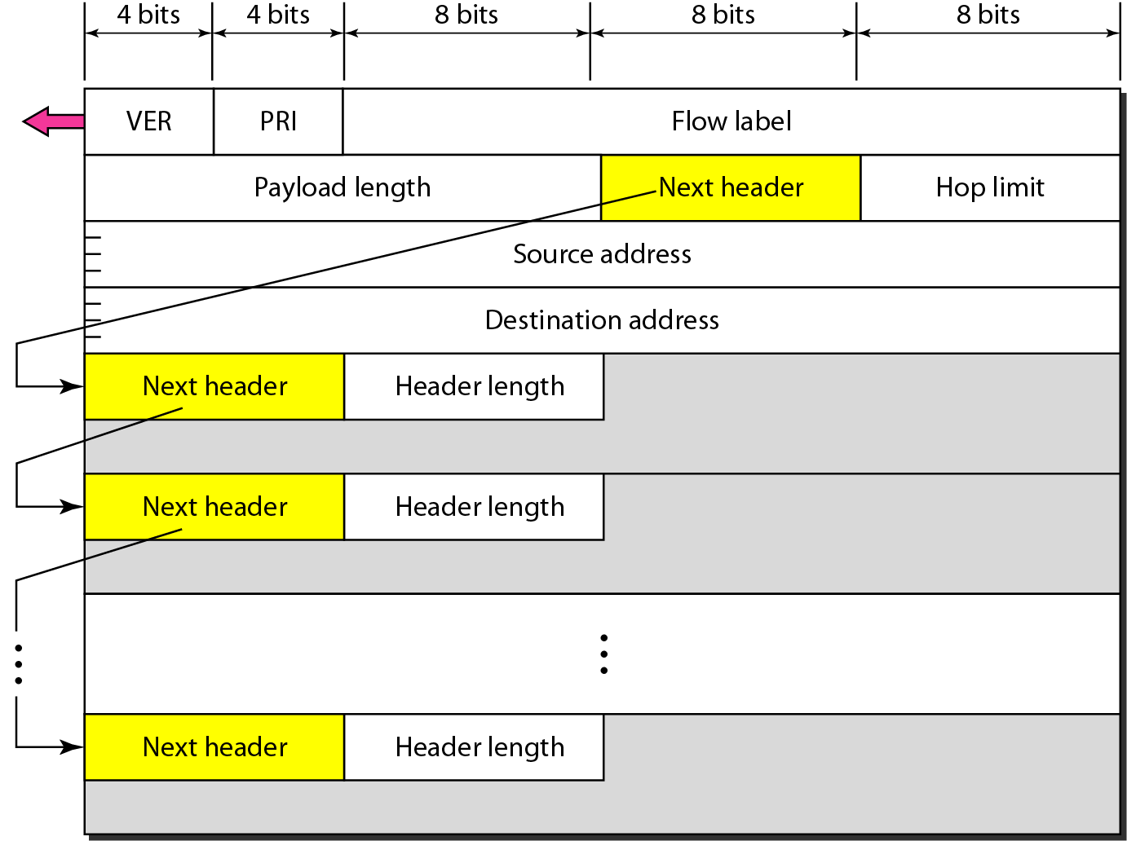
Format of an IPv6 datagram

Slide 77
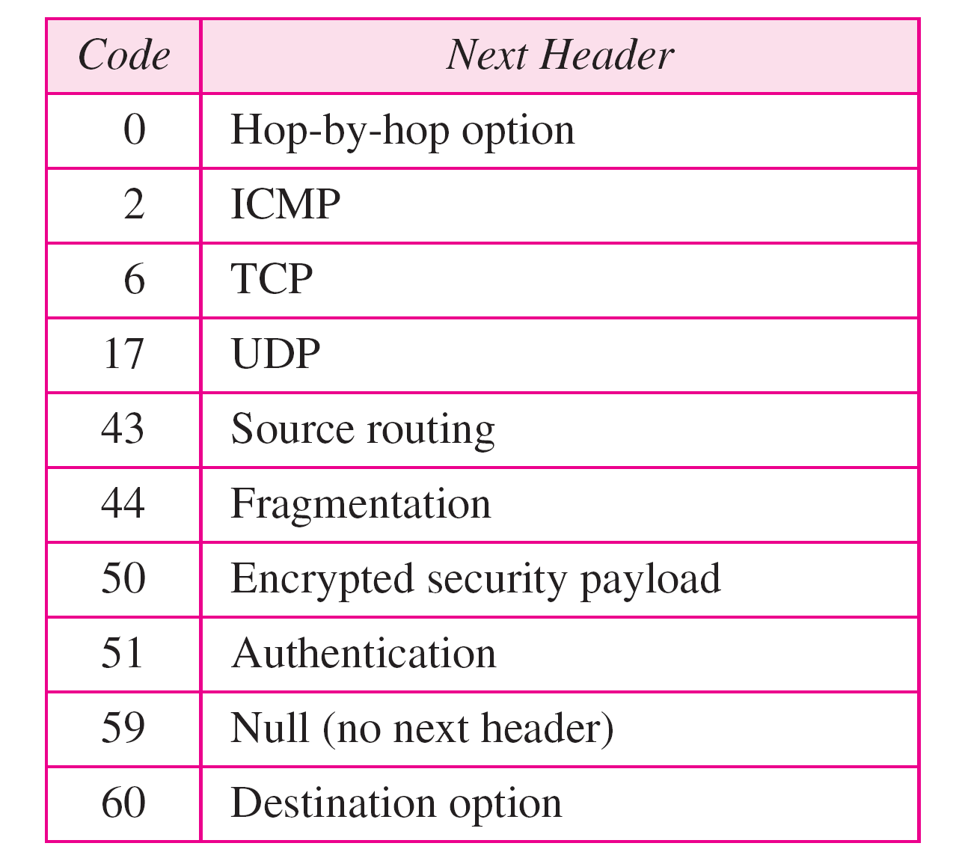
Next header codes for IPv6

Slide 78
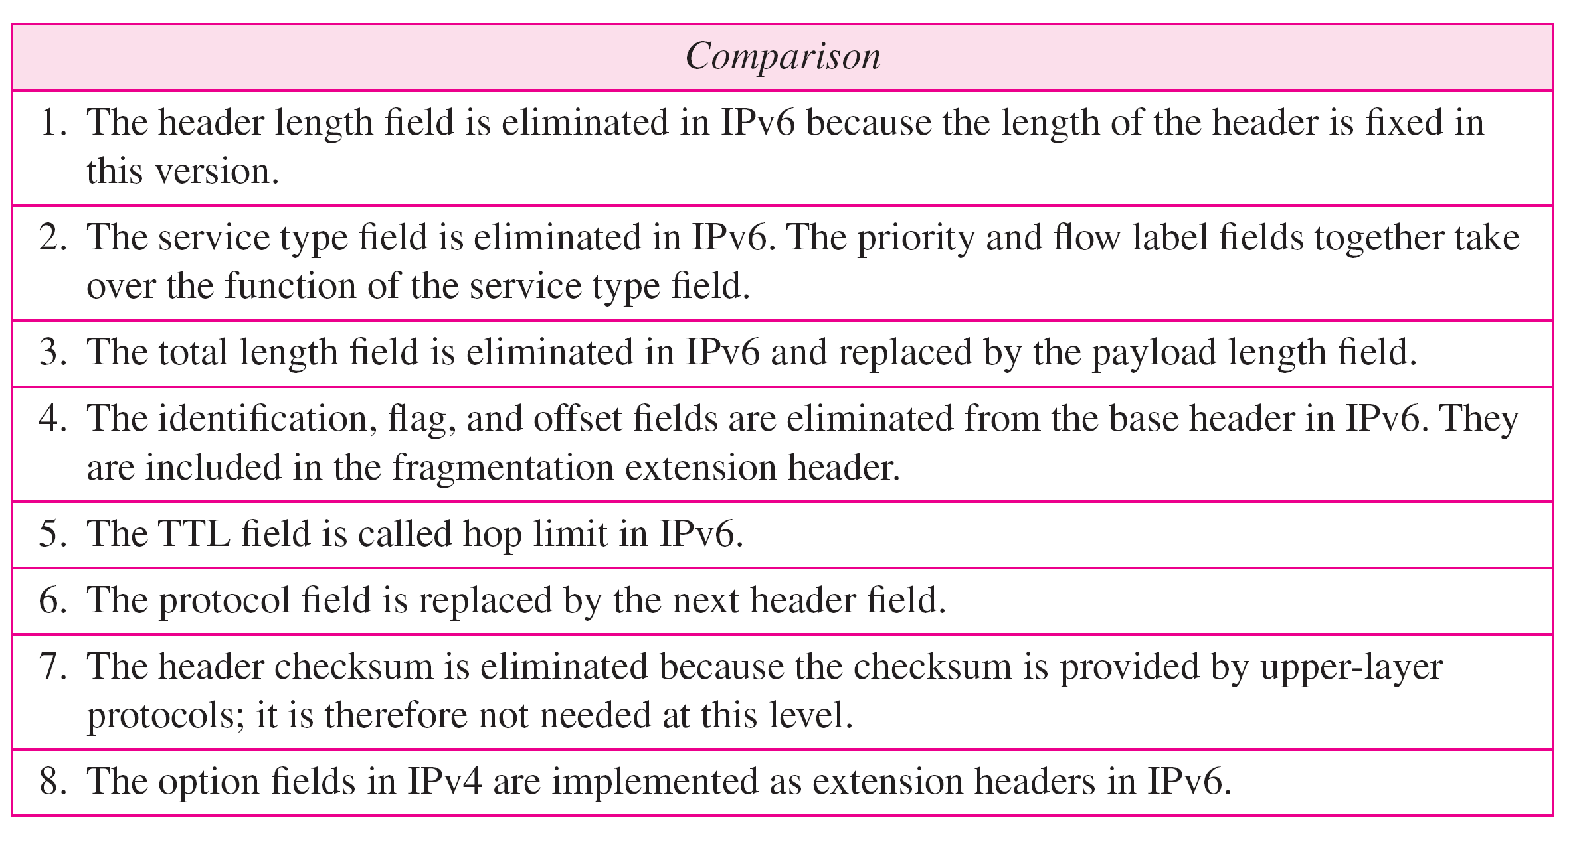
Comparison between IPv4 and IPv6 packet headers

Slide 79
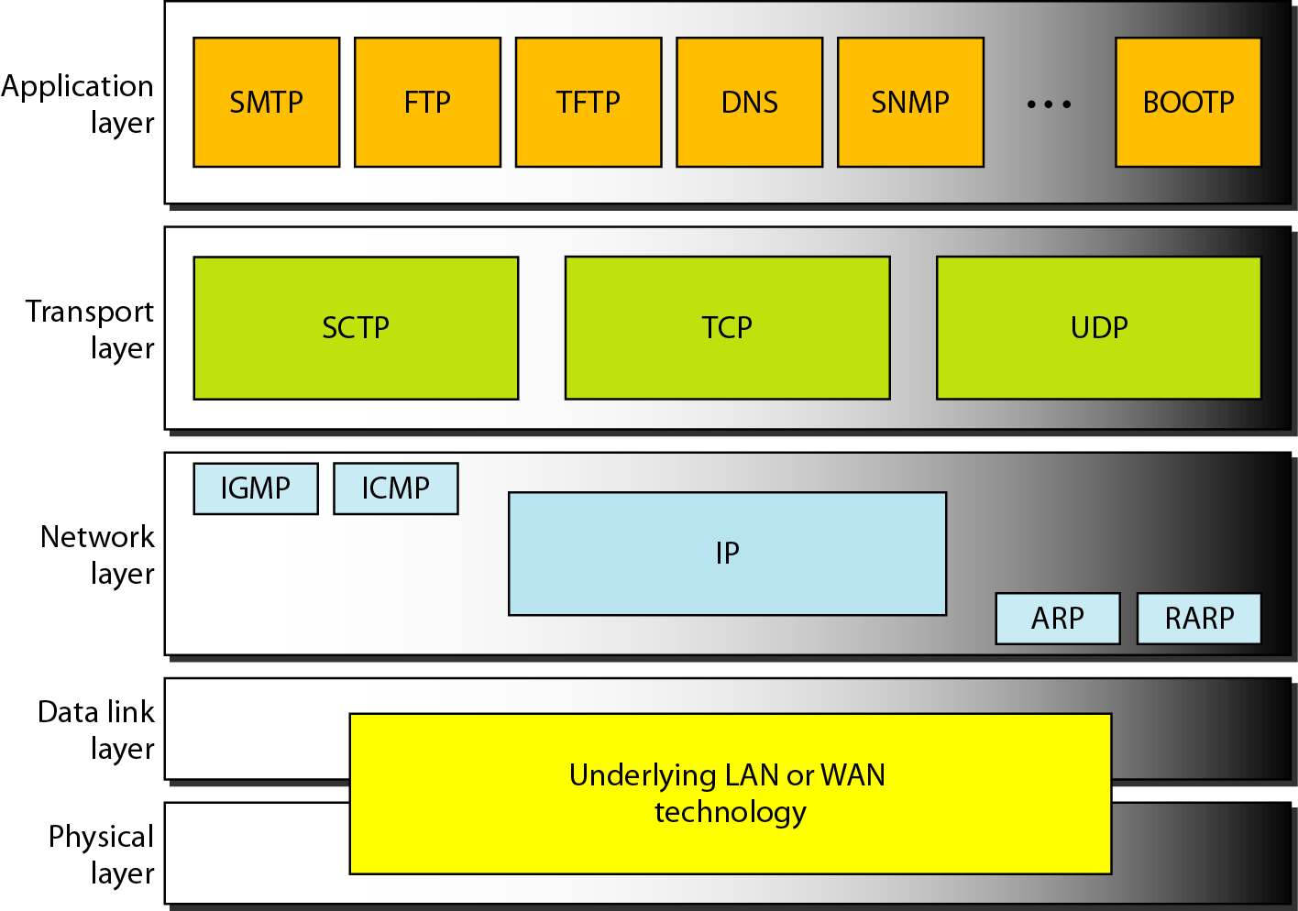
TCP Protocol

Slide 80
TCP
TCP is a connection-oriented protocol
It creates a virtual connection between two TCPs to send data
In addition, TCP uses flow and error control mechanisms at the transport level

Slide 81
TCP segments
The bytes of data being transferred in each connection are numbered by TCP
The numbering starts with an arbitrarily generated number

Slide 82
Eg:
Suppose a TCP connection is transferring a file of 5,000 bytes. The first byte is numbered 10,001. What are the sequence numbers for each segment if data are sent in five segments, each carrying 1,000 bytes?

Slide 83
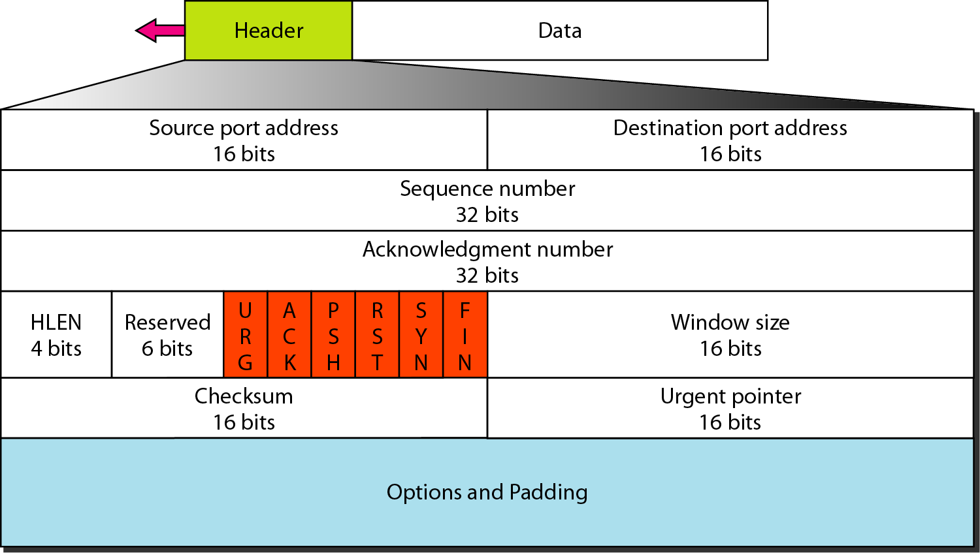
TCP segment format

Slide 84
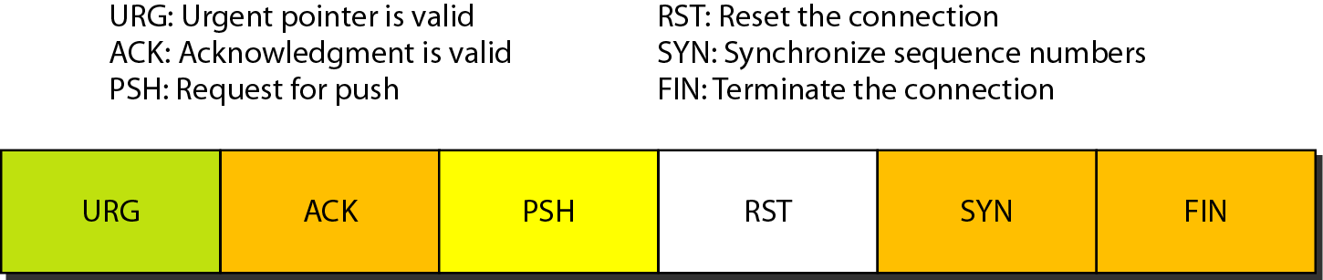
Control field

Slide 85
TCP Window Management
TCP uses two windows (send window and receive window) for each direction of data transfer, which means four windows for a bidirectional communication
To make the discussion simple, we make an assumption that communication is
only unidirectional
The bidirectional communication can be inferred using two unidirectional communications with piggybacking

Slide 86
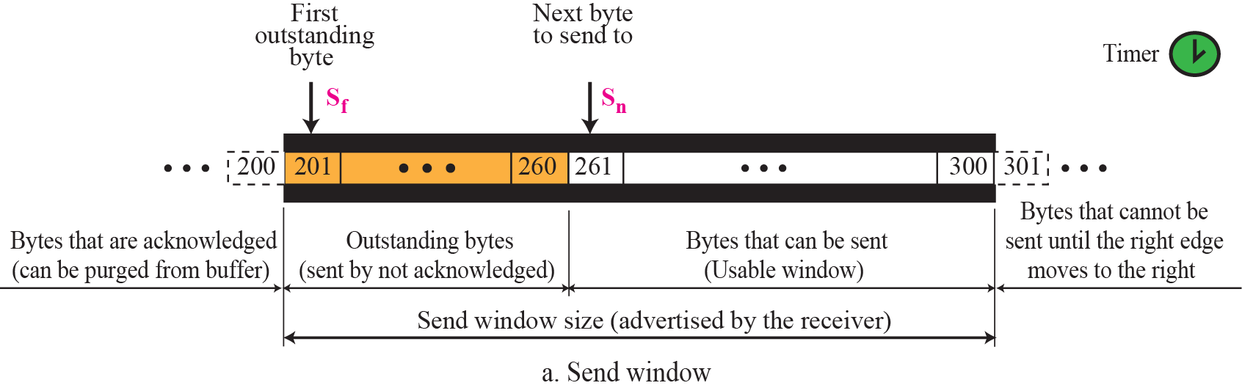
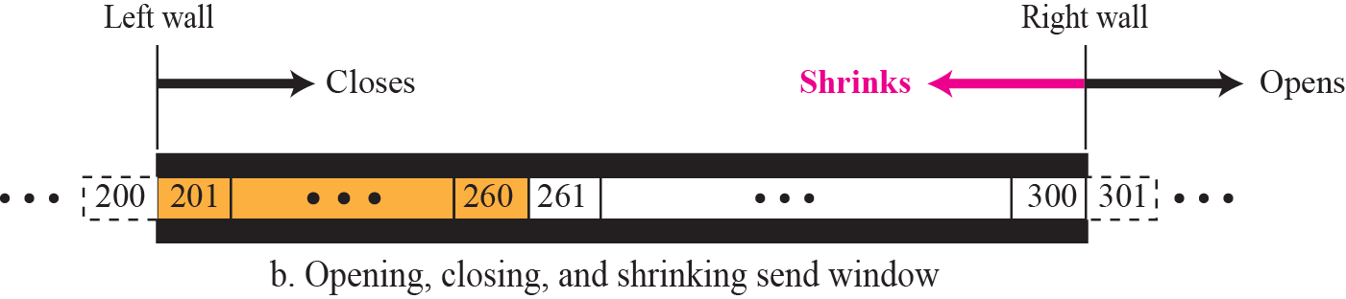
Send window in TCP

Slide 87
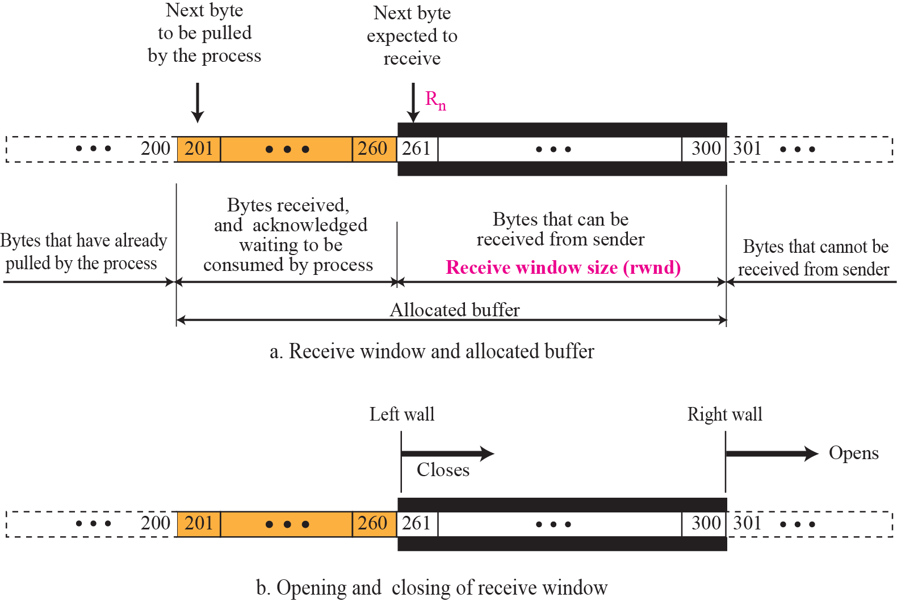
Receive window in TCP

Slide 88
TCP connection
TCP is connection-oriented and it establishes a virtual path between the source
and destination
TCP, which uses the services of IP, a connectionless protocol, can be connection- oriented
All of the segments belonging to a message are sent over this virtual path
The point is that a TCP connection is virtual, not physical
TCP operates at a higher level and uses the services of IP to deliver individual
segments to the receiver, but it controls the connection itself
If a segment is lost or corrupted, it is retransmitted

Slide 89
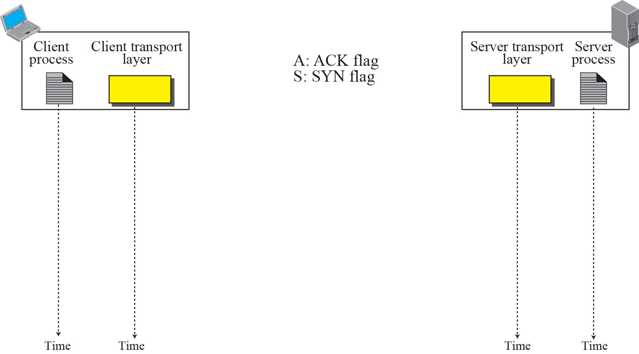




Connection establishment using three-way handshake
seq: 8000
S
SYN
seq: 15000
ack: 8001
A S
rwnd: 5000
SYN + ACK
seq: 8000
ack: 15001
A
rwnd: 10000
ACK
Means “no data” !
seq: 8001 if piggybacking

Slide 90

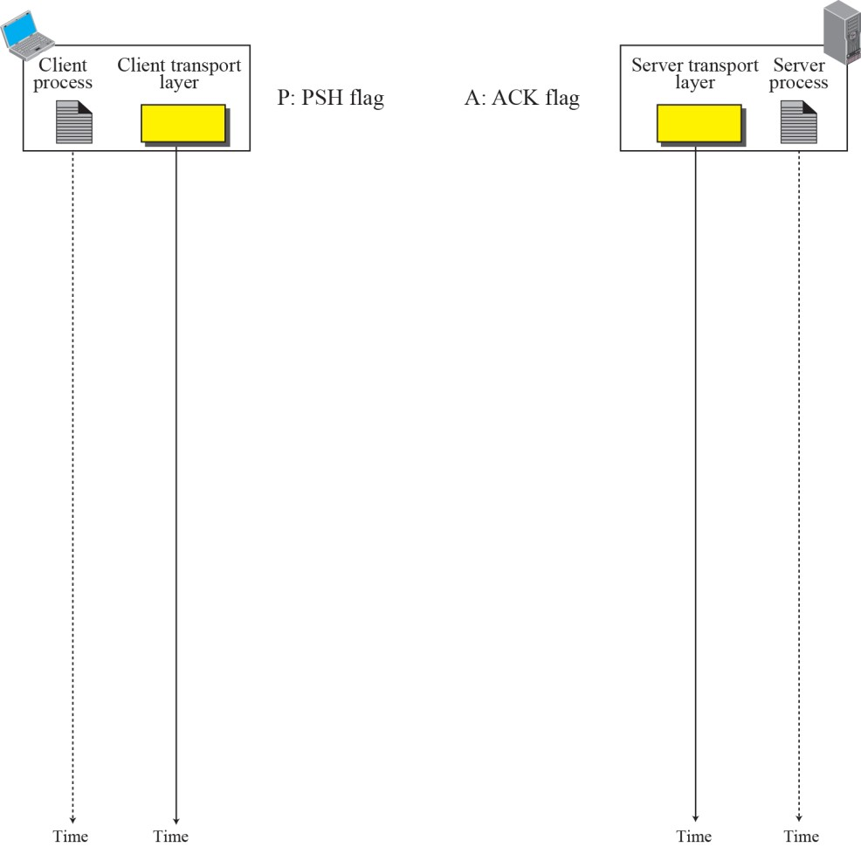
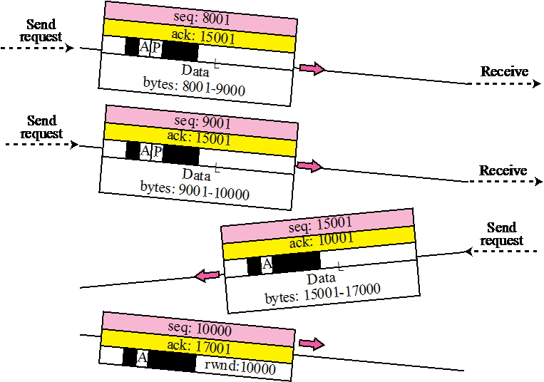
Data transfer
Pushing data Urgent data
Connection Termination

Slide 91
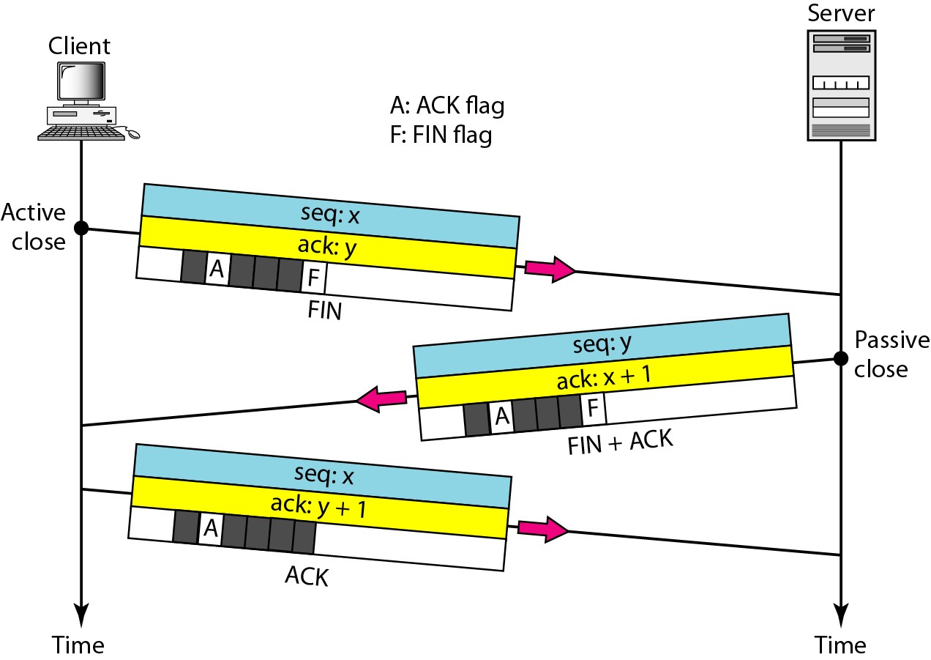
Connection termination using three-way handshaking

Slide 92
Congestion control
Congestion control in TCP is based on both open loop and closed-loop mechanisms
TCP uses a congestion window and a congestion policy that avoid congestion
and detect

Slide 93
UDP

Slide 94
UDP
UDP provides
best effort delivery
Connectionless
Unreliable
Out of order delivery
TCP
Reliable
In-order delivery
Congestion control
Flow control
Connection setup

Slide 95
UDP
The User Datagram Protocol (UDP) is called a connectionless, unreliable transport protocol
It does not add anything to the services of IP except to provide process-to-
process communication instead of host-to-host communication

Slide 96
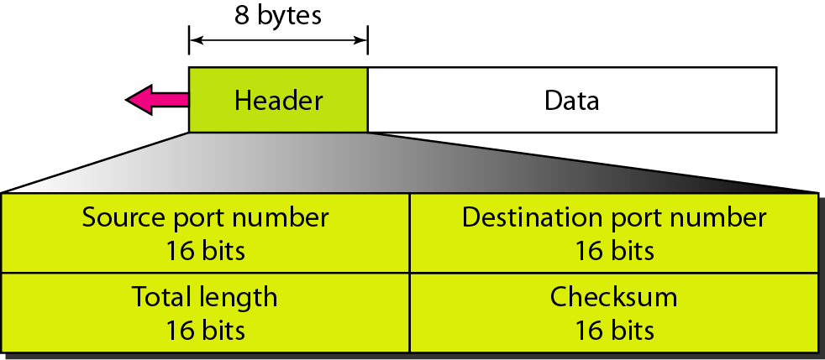
UDP format

Slide 97
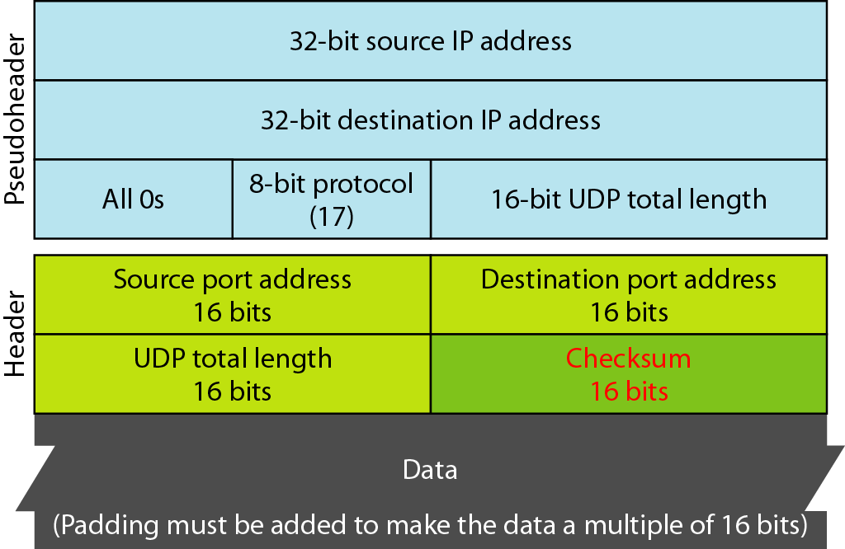
Pseudoheader for checksum calculation

Slide 98
FTP

Slide 99
FTP
File Transfer Protocol (FTP) is the standard mechanism provided by TCP/IP for copying a file from one host to another

Slide 100
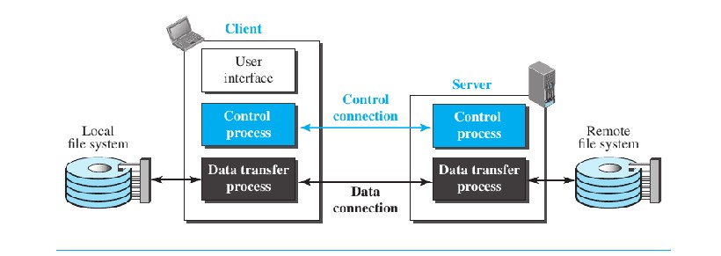
FTP
FTP uses the services of TCP
It needs two TCP connections
The well-known port 21 is used for the control connection and the well-known
port 20 for the data connection

Slide 101
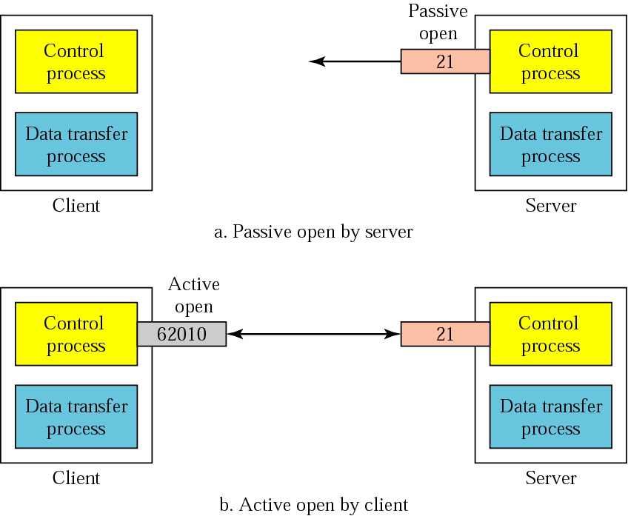
Opening the control connection

Slide 102
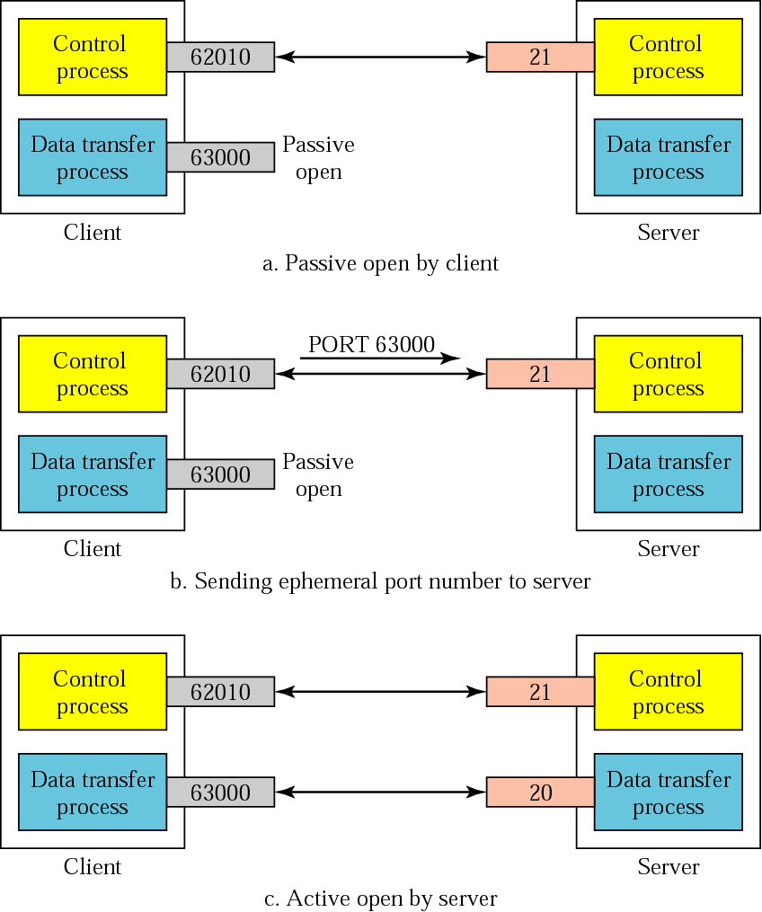
Creating the data connection

Slide 103
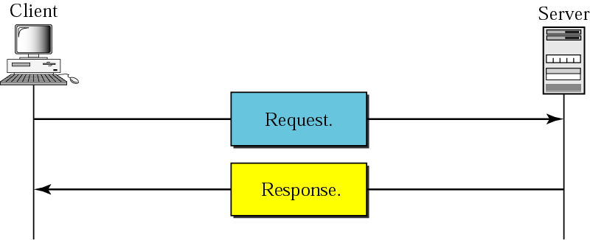
HTTP transaction

Slide 104
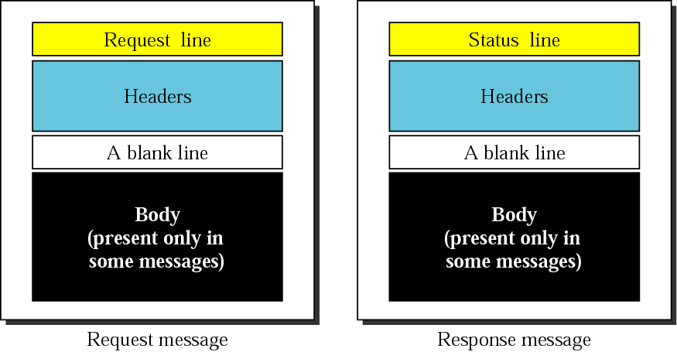
Request and response messages

Slide 105
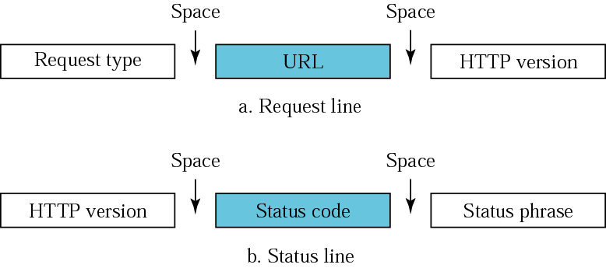
Request and status lines

Slide 106
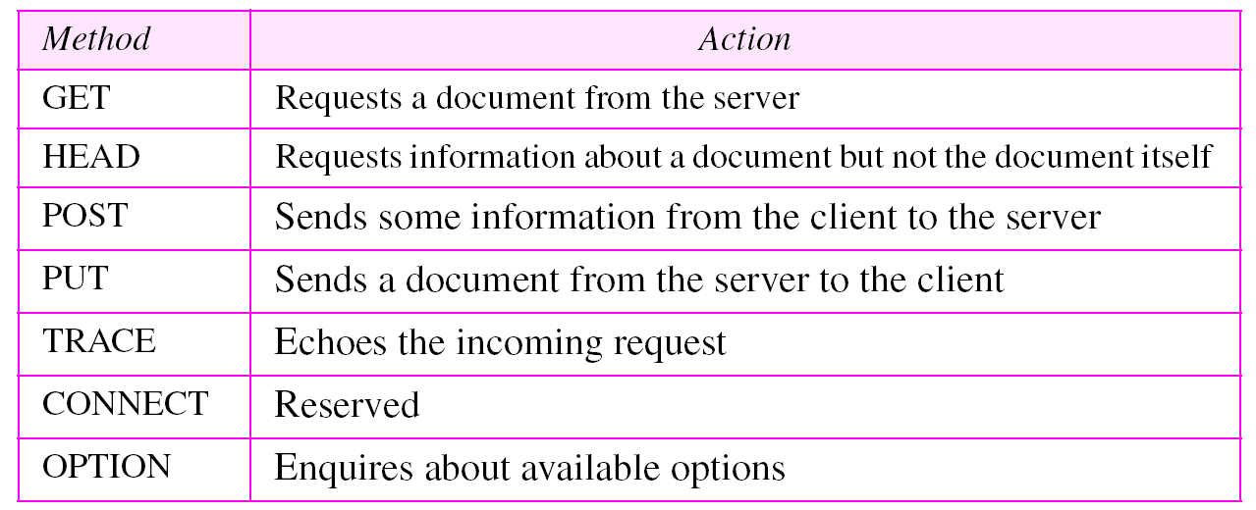
Methods

Slide 107

Header format

Slide 108

Example
HTTP version 1.1 specifies a persistent connection by default

Slide 109

Example

